Slide 1
Machine Learning - 1
Unit 3

Slide 2
Bayesian Classifier
(Kindly Refer Unit3 – Naïve Bayes)

Slide 3
kNN

Slide 4
k Nearest Neighbour (kNN)
In simple terms
kNN is a supervised machine learning algorithm that can be used both for classification and regression.
kNN is used for binary classification and multi-class classification.
Objective
The goal of the kNN algorithm is to divide the dataset into several classes and predict the new data point’s class.

Slide 5
kNN’s learning
1. Instance-based learning
Here we do not learn weights from training data to predict output but use entire training instances to predict output for unseen data.
2. Lazy learning
Model is not learned using training data prior and the learning process is postponed to a time when prediction is requested on the new instance.
3. Non-parametric
In KNN, there is no predefined form of the mapping function.

Slide 6

kNN
Objective
The KNN algorithm assumes that similar things exist in close proximity. In other words, similar things are near to each other.
Therefore, kNN considers K Nearest Data points to predict the class or continuous value for the new Datapoint.

Slide 7
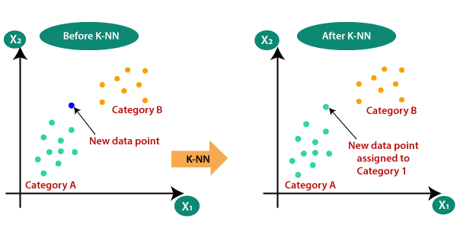
Working of kNN
K-nearest neighbors (KNN) algorithm uses ‘feature similarity’ to predict the values of new datapoints .
The new data point will be assigned a value based on how closely it matches the points in the training set.

Slide 8
kNN Algorithm
Step 1 − For implementing any algorithm, we need dataset. So during the first step of KNN, we must load the training as well as test data.
Step 2 − Next, we need to choose the value of K i.e. the nearest data points. K can be any integer (1,2,3…).
Step 3 − For each point in the test data do the following −

Slide 9
kNN Algorithm
3.1 − Calculate the distance between test data and each row of training data with the help of any of the method namely: Euclidean, Manhattan or Hamming distance.
3.2 − Now, based on the distance value, sort them in ascending order.
3.3 − Next, it will choose the top K rows from the sorted array.
3.4 − Now, it will assign a class to the test point based on most frequent class of these rows.
Step 4 − End

Slide 10
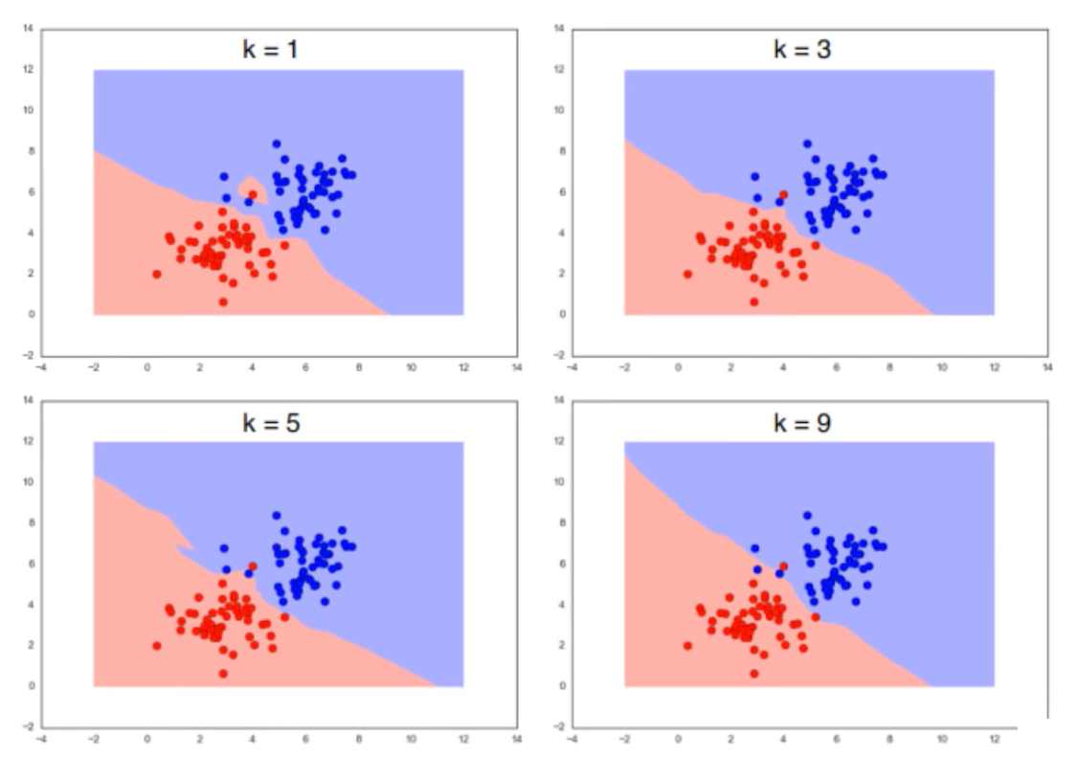
k in kNN algorithm
‘k’ is the
number of nearest neighbor

Slide 11
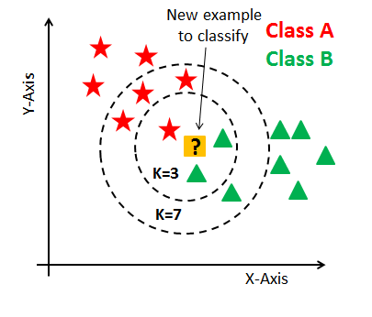
kNN with different ‘k’ values
It works by calculating the distance of 1 test observation from all the observation of the training dataset and then finding K nearest neighbors of it.
This happens for each and every test observation and that is how it finds similarities in the data.

Slide 12
kNN : Choosing ‘k’ value
There is no particular way to determine the best value for "K", so we need to try some values to find the best out of them. The most preferred value for K is 5.
A very low value for K such as K=1 or K=2, can be noisy and lead to the effects of outliers in the model.
Large values for K are good, but every datapoint will be classified as the most probable class. P(y)

Slide 13
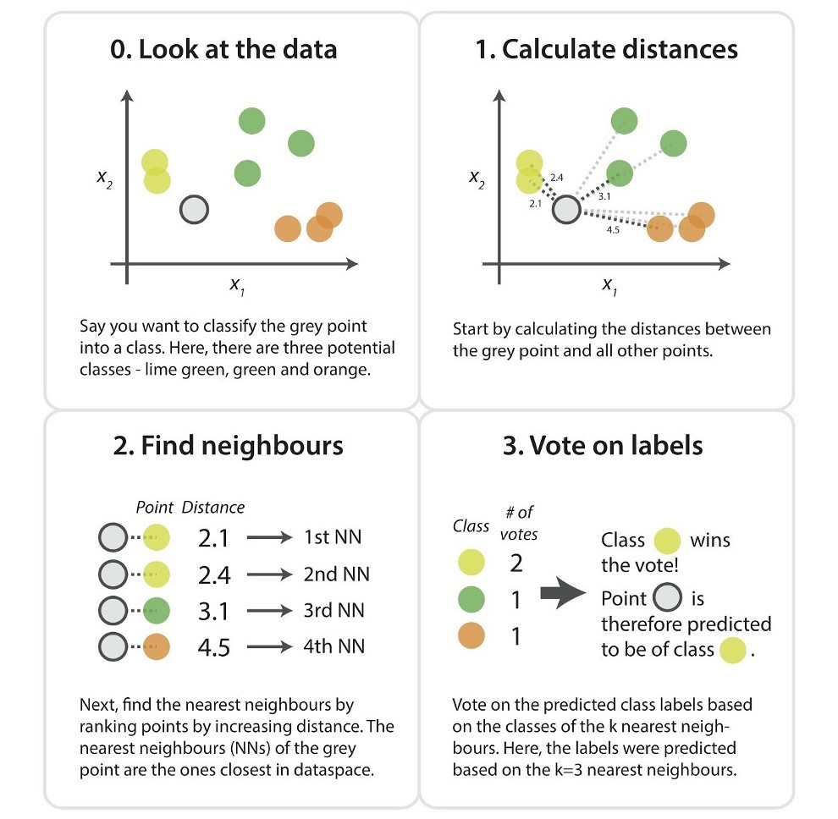
kNN : Steps

Slide 14
kNN - Advantages
It is simple to implement.
It is robust to the noisy training data
It can be more effective if the training data is large.
kNN - Disadvantages
Always needs to determine the value of K which may be complex some time.
The computation cost is high because of calculating the distance between the data points for all the training samples.

Slide 15
Application:
Face Recognition with PCA

Slide 16
PCA – Principal Component Analysis
PCA, is a dimensionality-reduction method that is often used to reduce the dimensionality of large data sets, by transforming a large set of variables into a smaller one that still contains most of the information in the large set.
Application:
Face recognition using PCA :
URL: (108) Face Recognition using PCA | Face Recognition Machine Learning - YouTube

Slide 17
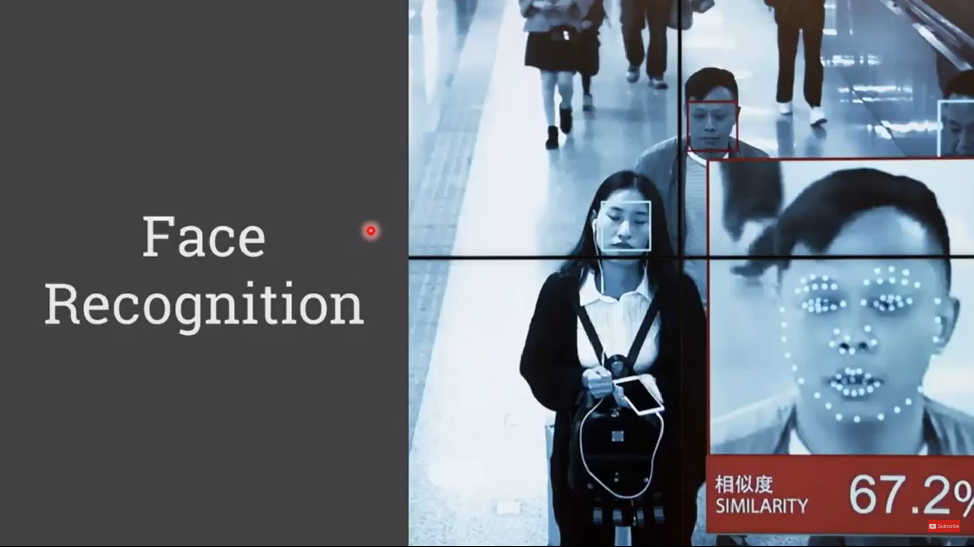
Face recognition using PCA

Slide 18
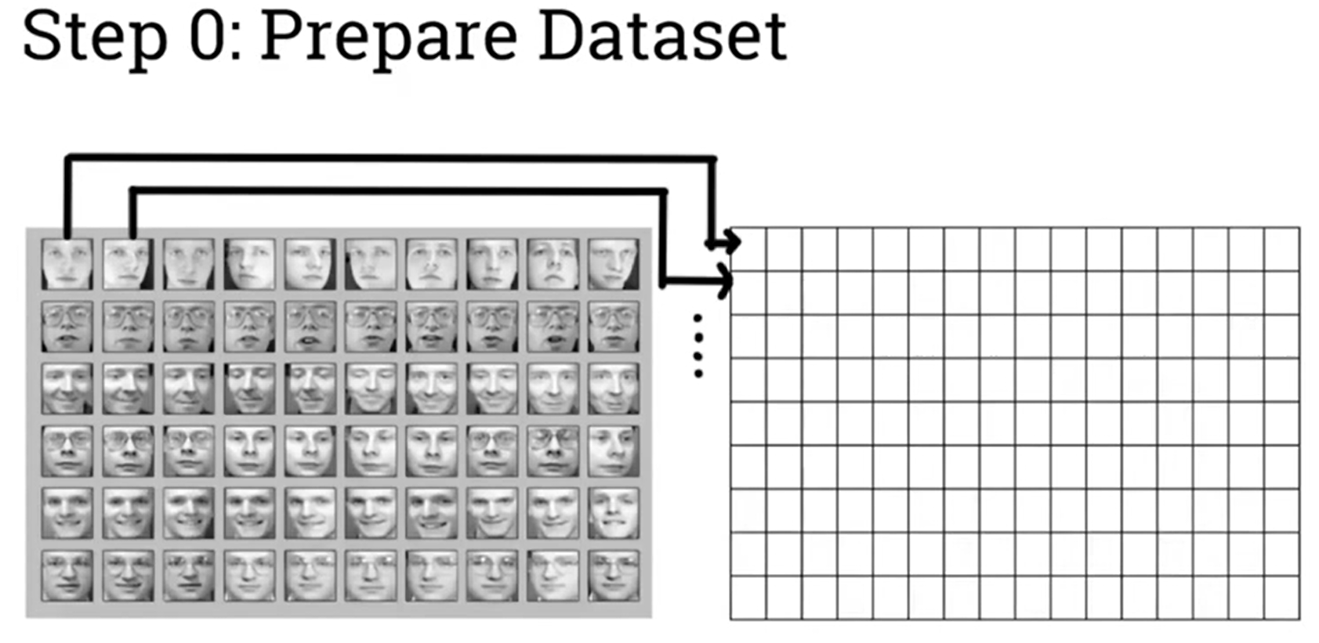
Dataset:
Face_data.csv
Face recognition using PCA
Each Image is 64 x 64 = 4096 pixels. These pixels are flattened in 4096 columns
Person1-- >
Person2-- >
Person3-- >
Person4-- >
Person5-- >
Person6-- >

Slide 19
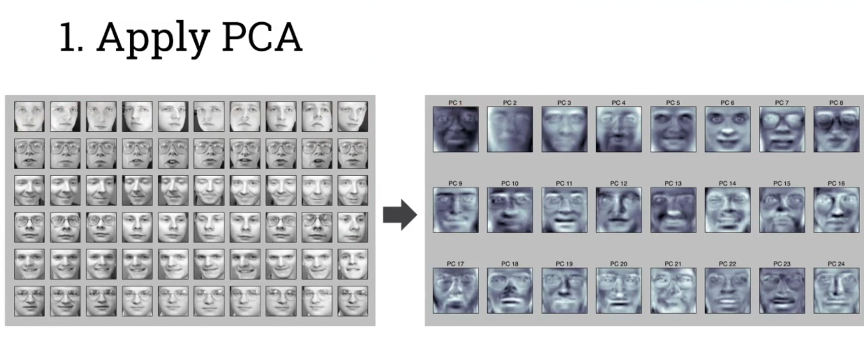
Dataset:
Face_data.csv
Face recognition using PCA
Applying PCA and extracting principal components of the dataset with maximum variance.
Principal Component 1
Principal Component 2
Rather than dealing with raw image, PCA deals with low dimension representation of data

Slide 20
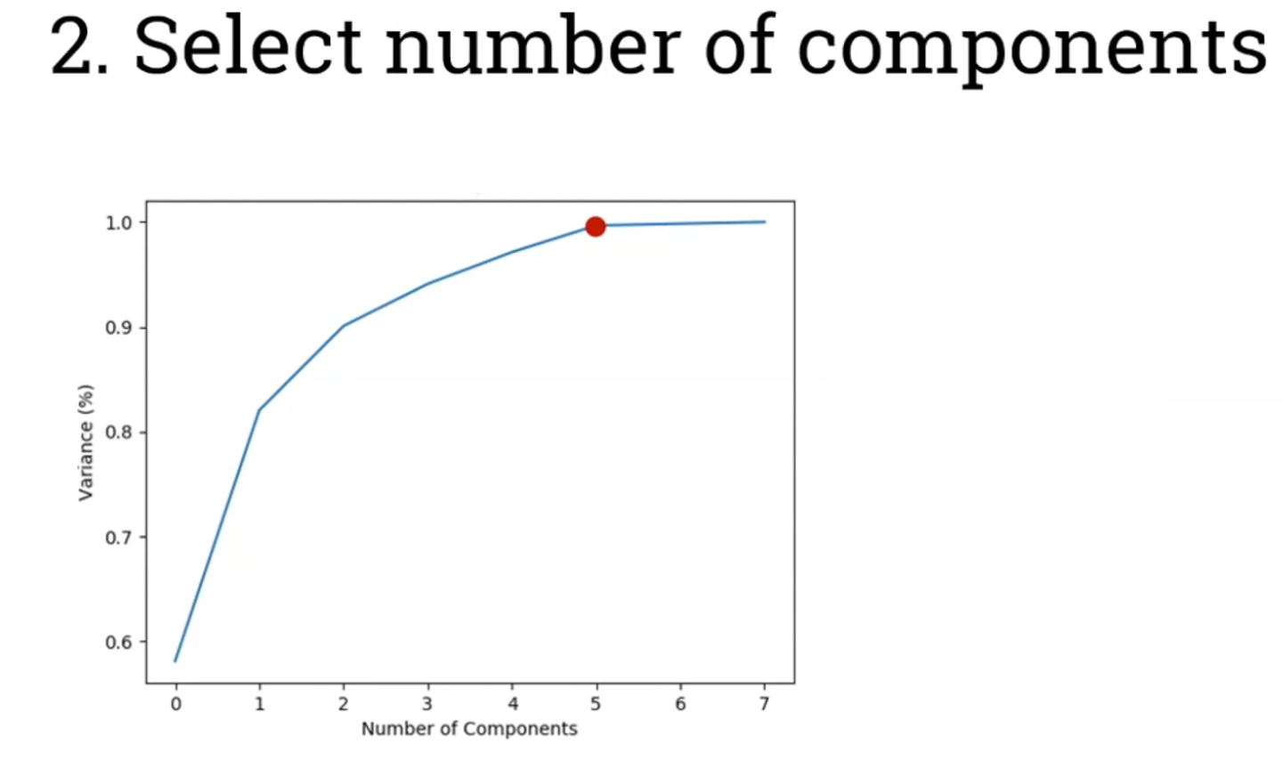
Dataset:
Face_data.csv
Face recognition using PCA
How many components should we select ? Analyze from the graph
In this graph, the first 5 principal component shows high variance of upto 95%. However, there is no much variance after PC5 . So apply PCA to remove PC6 and PC7.

Slide 21
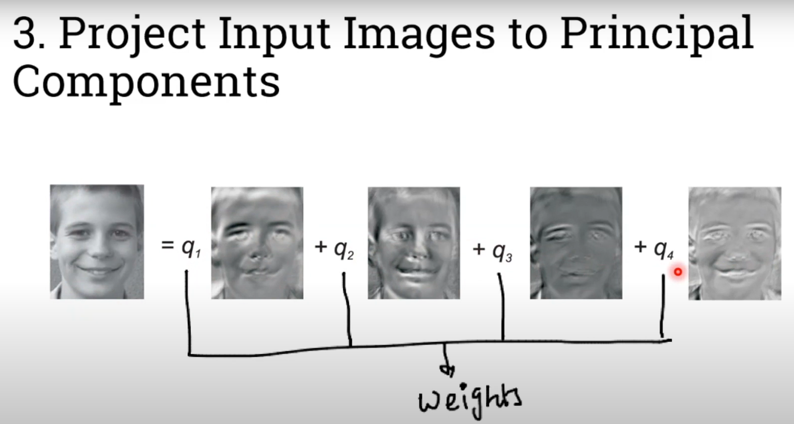
Dataset:
Face_data.csv
Face recognition using PCA
Original image = (Weight q1 x Eigenvector1) + (Weight q2 x Eigenvector2)
+ (Weight q3 x Eigenvector3) + (Weight q4 x Eigenvector4)
Therefore, only 4 variables (for weights) are needed to represent the original image.

Slide 22
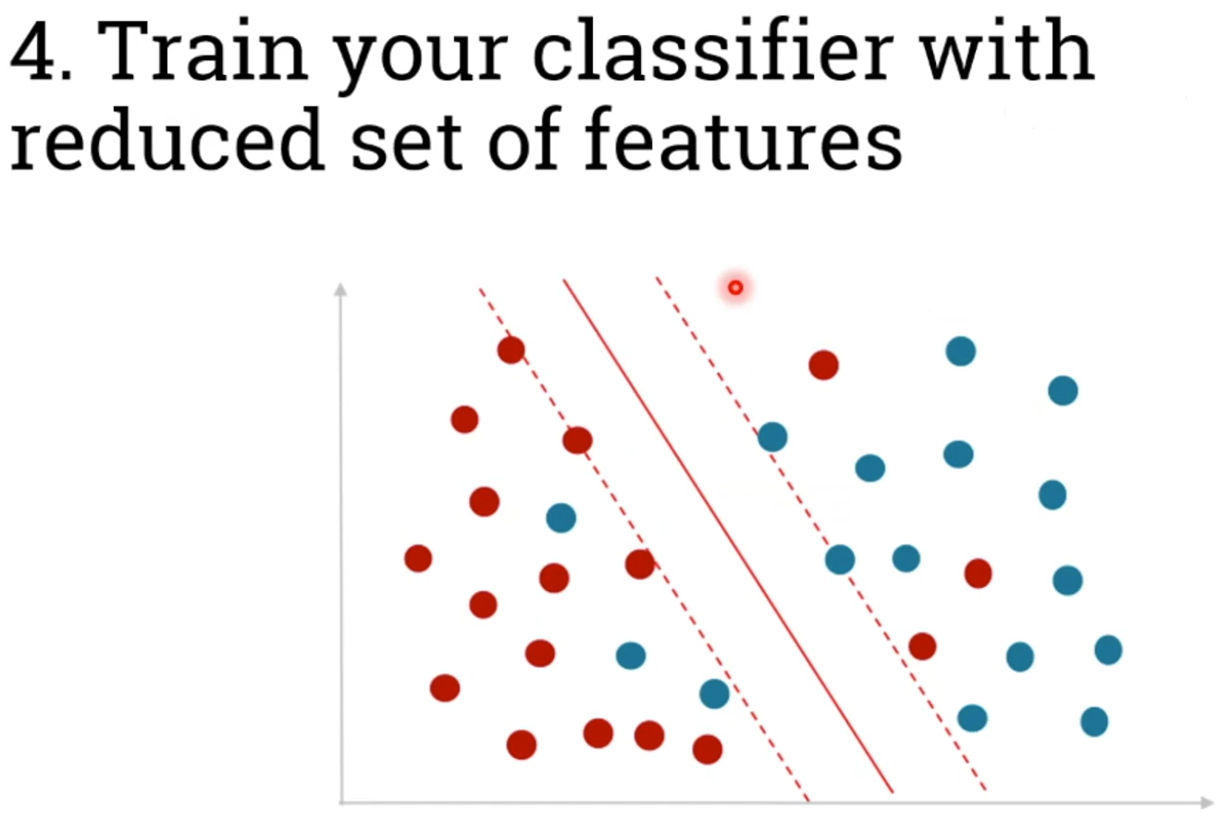
Dataset:
Face_data.csv
Face recognition using PCA

Slide 23
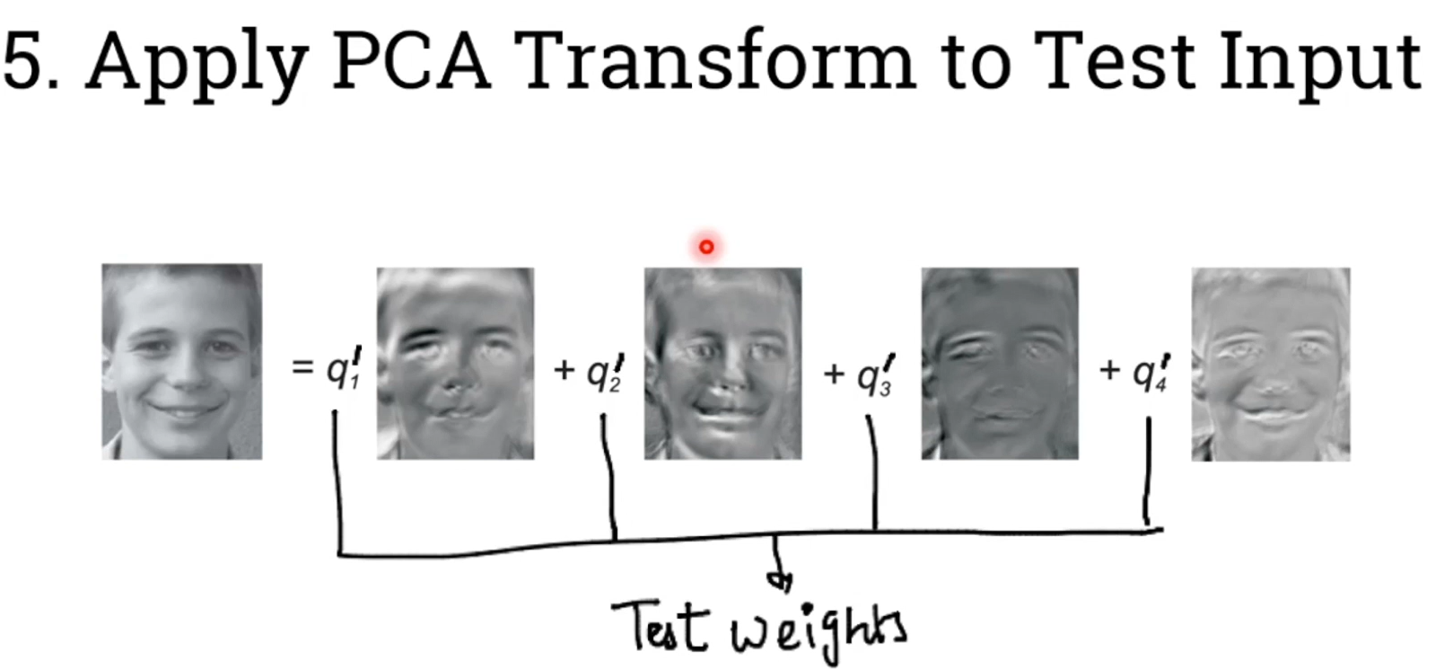
Dataset:
Face_data.csv
Face recognition using PCA
Original image = (TestWeight q1 x Eigenvector1) + (TestWeight q2 x Eigenvector2)
+ (TestWeight q3 x Eigenvector3) + (TestWeight q4 x Eigenvector4)

Slide 24
Summary

Slide 25
Thank You

